Slide 1

The while Loop
Loops
A part of a program is repeated over and over, until a specific goal is reached
For calculations that require repeated steps
For processing input consisting of many data items

Slide 2
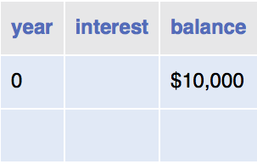
The while Loop
Investment problem You put $10,000 into a bank account that earns 5 percent interest per year. How many years does it take for the account balance to be double the original investment?
The algorithm
Start with a year value of 0, a column for the interest, and a balance of $10,000.
Repeat the following steps while the balance is less than $20,000.
Add 1 to the year value.
Compute the interest as balance x 0.05 (i.e., 5 percent interest).
Add the interest to the balance.
Report the final year value as the answer.

Slide 3
The while Loop
How can you “Repeat steps while the balance is less than $20,000?”
With a while loop statement
Syntax
while (condition)
{
statements
}
As long as condition is true, the statements in the while loop execute.

Slide 4
The while Loop
The code:
int year = 0;
double balance = 10000;
double targetBalance = 20000;
while (balance < targetBalance)
{
year++;
double interest = balance * .05;
balance = balance + interest;
}
System.out.println(“In “ + year + “ years, my balance will be: “ + balance);

Slide 5
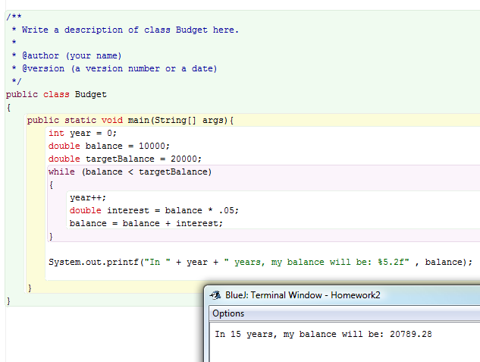

Slide 6
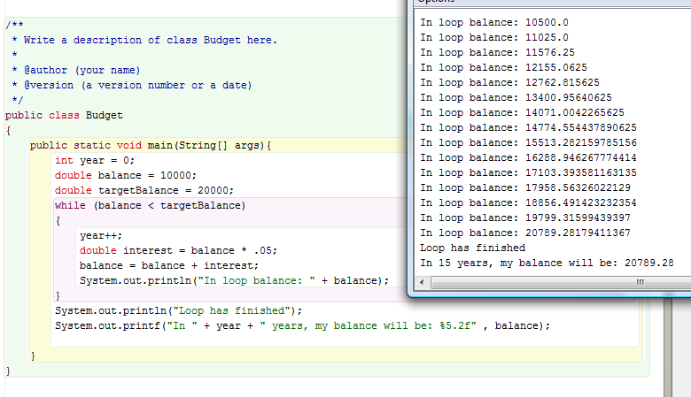
Or you can just use the debugger!!!!!

Slide 7
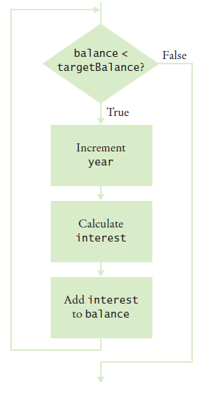
The while Loop
Figure 1 Flowchart of a while Loop

Slide 8
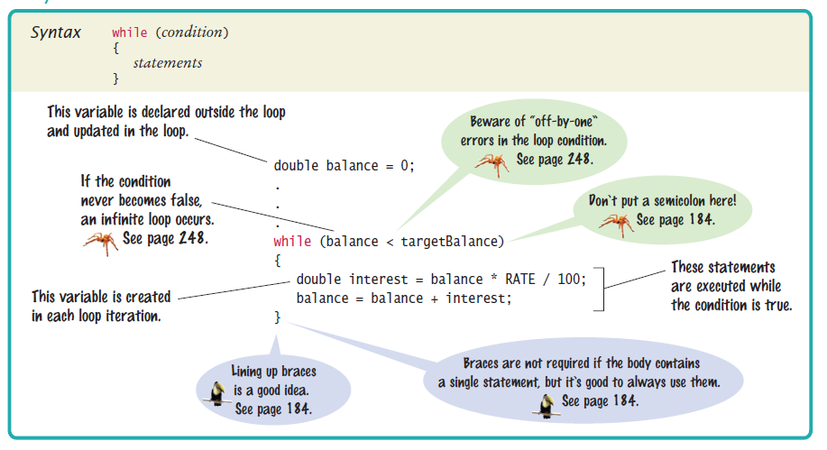
Syntax 6.1 while Statement

Slide 9
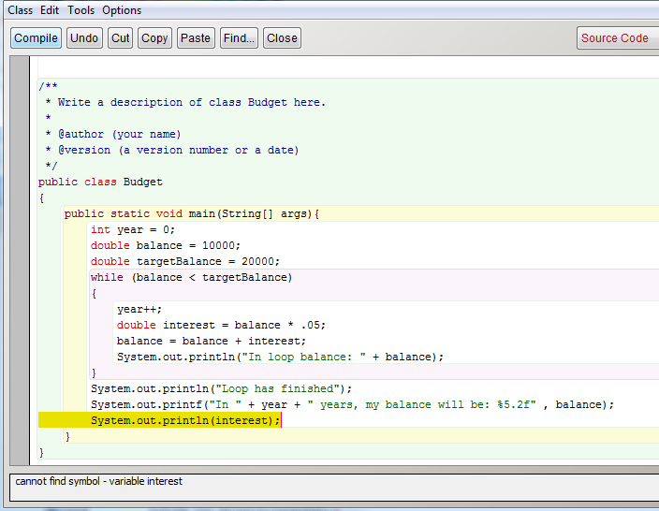

Slide 10
The while Loop
For a variable declared inside a loop body:
Variable is created for each iteration of the loop
And removed after the end of each iteration
while (balance < targetBalance)
{
year++;
double interest = balance * RATE / 100;
balance = balance + interest;
}
// interest no longer declared here

Slide 11
Common Error: Infinite Loops
Example:
forgetting to update the variable that controls the loop
int years = 1;
while (years <= 20)
{
double interest = balance * RATE / 100;
balance = balance + interest;
}
Example:
incrementing instead of decrementing
int years = 20;
while (years > 0)
{
double interest = balance * RATE / 100;
balance = balance + interest;
years++;
}
These loops run forever – must kill program

Slide 12
Common Error: Off-by-One Errors
Off-by-one error: a loop executes one too few, or one too many, times.
Example:
int years = 0;
while (balance < targetBalance)
{
years++;
balance = balance * (1 + RATE / 100);
}
System.out.println("The investment doubled after " +
year + " years.");
Should years start at 0 or 1?
Should the test be < or <= ?

Slide 13
Problem Solving: Hand-Tracing
A simulation of code execution in which you step through instructions and track the values of the variables.
What value is displayed?
int n = 1729;
int sum = 0;
while (n > 0)
{
int digit = n % 10;
sum = sum + digit;
n = n / 10;
}
System.out.println(sum);

Slide 14
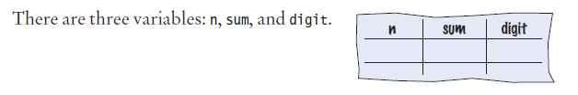
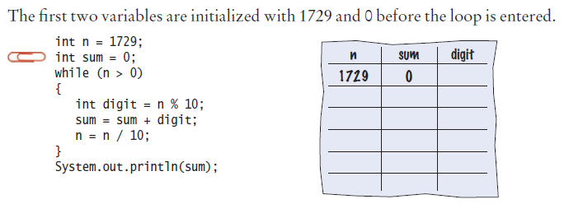
Problem Solving: Hand-Tracing - Step by Step
Step 1
Step 2

Slide 15
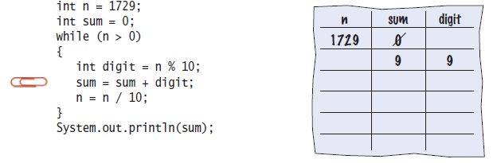
Problem Solving: Hand-Tracing - Step by Step
Step 3

Slide 16
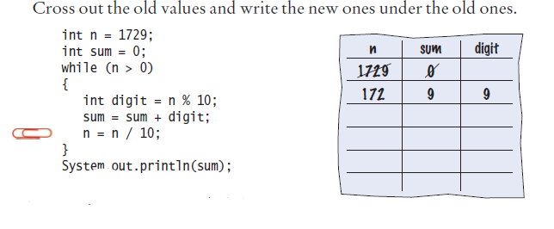
Problem Solving: Hand-Tracing - Step by Step
Step 4

Slide 17
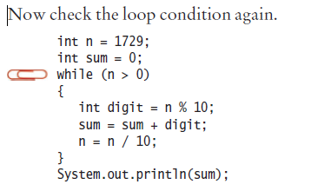
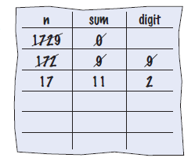
Problem Solving: Hand-Tracing - Step by Step
Step 5

Slide 18
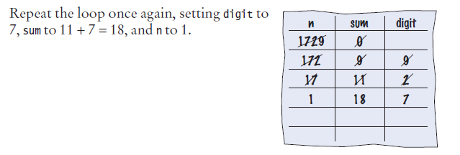
Problem Solving: Hand-Tracing - Step by Step
Step 6

Slide 19
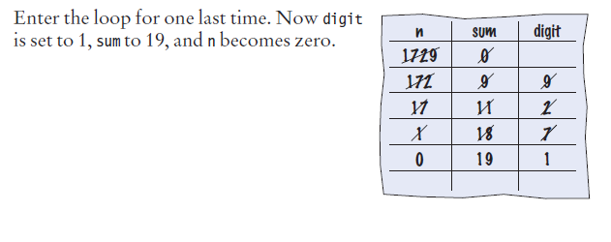
Problem Solving: Hand-Tracing - Step by Step
Step 7

Slide 20
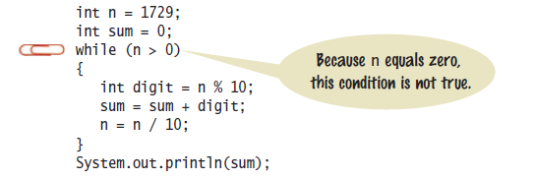
Problem Solving: Hand-Tracing - Step by Step
Step 8

Slide 21
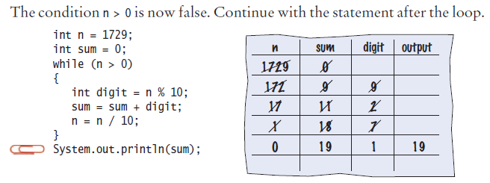
Problem Solving: Hand-Tracing - Step by Step
Step 9
Step 10 The sum, which is 19, is printed

Slide 22
Self Check 6.6
Hand-trace the following code, showing the value of n and the output.
int n = 5;
while (n >= 0)
{
n--;
System.out.print(n);
}
Answer:
n output
5
4 4
3 3
2 2
1 1
0 0
-1 -1

Slide 23
Self Check 6.7
Hand-trace the following code, showing the value of n and the output. What potential error do you notice?
int n = 1;
while (n <= 3)
{
System.out.print(n + ", ");
n++;
}
Answer:
n output
1 1,
2 1, 2,
3 1, 2, 3,
4
There is a comma after the last value. Usually, commas are between values only.

Slide 24
Self Check 6.8
Hand-trace the following code, assuming that a is 2 and n is 4. Then explain what the code does for arbitrary values of a and n.
int r = 1;
int i = 1;
while (i <= n)
{
r = r * a;
i++;
}
Answer:
a n r i
2 4 1 1
2 2
4 3
8 4
16 5
The code computes a^{n}.

Slide 25
Self Check 6.9
Trace the following code. What error do you observe?
int n = 1;
while (n != 50)
{
System.out.println(n);
n = n + 10;
}
Answer:
n output
1 1
11 11
21 21
31 31
41 41
51 51
61 61
...
This is an infinite loop. n is never equal to 50.

Slide 26
Self Check 6.10
The following pseudo-code is intended to count the number of digits in the number n:
count = 1
temp = n
while (temp > 10)
Increment count
Divide temp by 10.0
Trace the pseudocode for n = 123 and n = 100. What error do you find?
Continued

Slide 27
Self Check 6.10
Answer:
count temp
1 123
2 12.3
3 1.23
This yields the correct answer. The number 123 has 3 digits.
count temp
1 100
10.0
This yields the wrong answer. The number 100 also has 3 digits. The loop condition should have been while (temp >= 10).

Slide 28
If you heard no message Upload: I think loops are: easy/hard? Choose easy or hard

